Slide 1
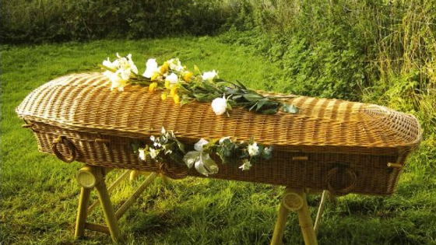
Green Burials

Slide 2
EASTER PEOPLE
“In death, the separation of the soul from the body, the human body decays and the soul goes to meet God, while awaiting its reunion with its glorified body. God, in His almighty power, will definitively grant incorruptible life to our bodies by reuniting them with our souls, through the power of Jesus' Resurrection.”
—Catechism of the Catholic Church, 997

Slide 3
What is A Green Burial? Why Choose it?
A green or "natural" burial conserves natural resources, preserves the environment and honors the full cycle of life. There is no vault, and everything used for the burial, including shrouds, caskets or urns, must be non-toxic and biodegradable.
The choice reflects our values of both the sanctity of human life and the care for God's creation.
Source: Sisters of Loretto Community
Notes:
The practice is similar to pre-mid-nineteenth century burials without embalming. Who was the first president to be embalmed? Abraham Lincoln.
Pope Francis – Laudato Si, Laudato Deum. Has promoted ecological responsibility and understanding the spiritual connectedness we have to creation
Green Burial is defined as “A way of caring for the dead with minimal environmental impact that aids in the conservation of natural resources, reduction of carbon emissions, protection of worker health, and the restoration and/or preservation of habitat.” (As defined by Green Burial Council Glossary). Green burial is an alternative to customary burial practices, where the deceased is buried directly into the ground in a wicker or similar container after being cleansed and prepared by a funeral director.

Slide 4
What MaKes a Green Burial Different?

Slide 5
TIMING
Traditional
Green
Flexibility with arrangements – sometimes a week or more
36 – 48 hours after death.
No viewing.
Notes:
Biodegradable embalming can be used to preserve the body for a short period of time. Funeral homes use refrigeration and using dry ice to preserve the body for approximately 1-3 days.

Slide 6
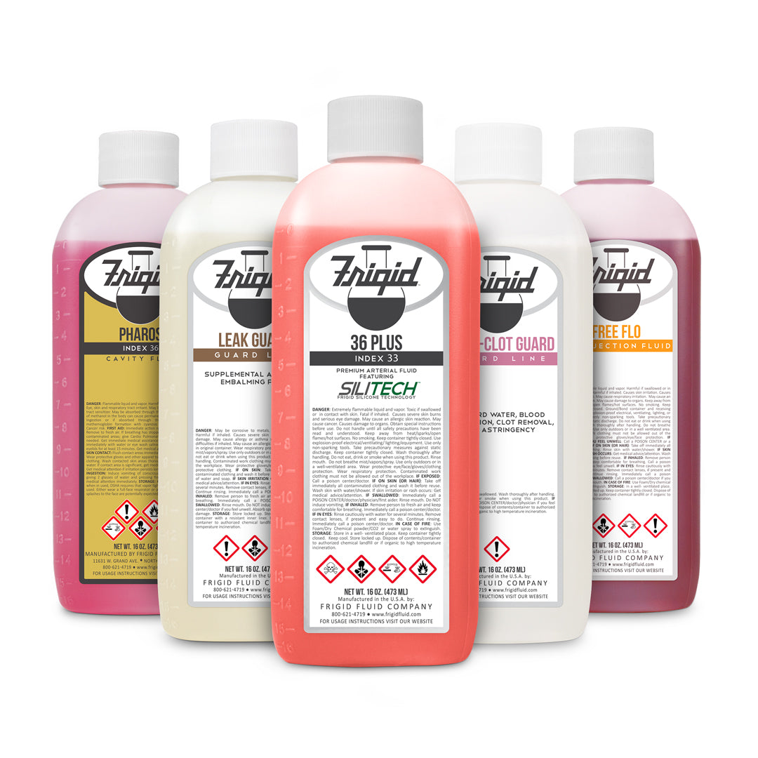
BODY
Traditional
Green
Embalmed
Cleansed
Notes:
Biodegradable embalming can be used

Slide 7
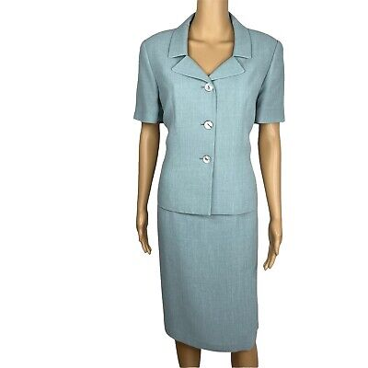
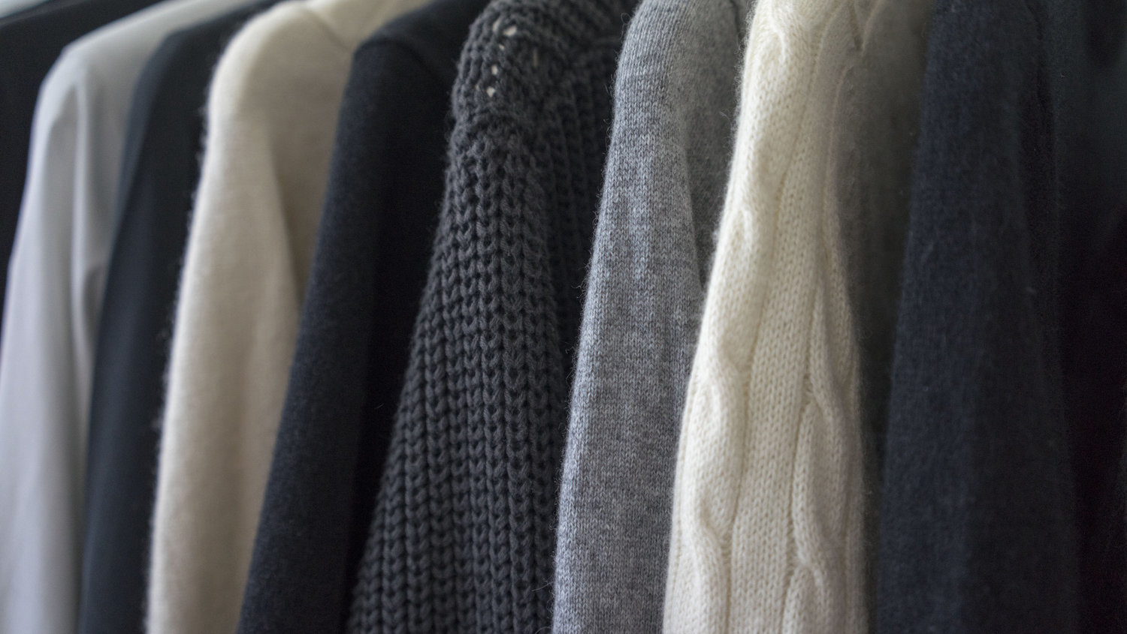
Clothing
Traditional
Green
You choose your polyester suit dress!
You choose natural fabrics only (cotton, linen, silk, wool, leather).
Notes:
Even zippers and plastic buttons should be avoided

Slide 8
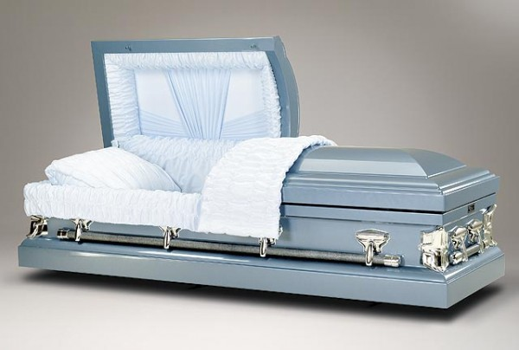
Casket
Traditional
Green
Made of steel, lined with synthetic fabrics
Made of biodegradable materials.
Notes:
Even zippers and plastic buttons should be avoided. Some green burials have bodies wrapped in a simple shroud made of natural materials; however, in our diocese, a wicker or cardboard casket is necessary to accommodate lowering devices at the gravesite.

Slide 9
Where?
Saint Catherine's Cemetery: natural burial section.
No choice of plot.
It will be less manicured.
Grave markers or plaques not permitted.
Source: Natural Burial Association
Notes:
Saint Catherine's Cemetery now has a natural burial section behind the Sisters of the Good Shepherd section.
The diocese currently has 12 graves available, can expand to 100 (and additional sections).
Less manicured – reduced mowing/landscaping requirements.
One marker for the entire green burial section will record the names of the interred.
The diocese has at least 3 funeral directors who've done green burials or are preparing for the need.

Slide 10
How is the Burial Different?
Hole is less deep (3'-4')
No concrete vaulting
Casket made of natural materials (e.g.: pine, wicker, bamboo)
Source: Green Burial Council
Notes:
Cost is the same! But you are reducing your carbon footprint!

Slide 11
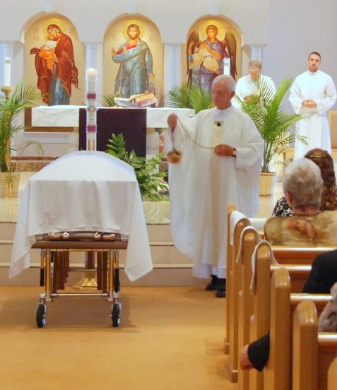
What Remains the Same?
A funeral liturgy still takes place. However, the body of the decedent is not present.
The Order of Christian Funerals remains the same at the burial site.
Notes:
This has to do with embalming practices... some dioceses will allow the body at the funeral... ours at this time doesn't.

Slide 12
Preparing for Green Burial
Pray about how your decision.
Notify your family of your intent for a green burial (important awareness for travel, as turnaround time from death to interment will be as short as 36 – 48 hours).
Notify the congregation of your intent for a green burial.
Update your intent in your will.

Slide 13
Articles & Resources
"Embracing Sustainability: Diocese of Scranton to Allow 'Green Burials'"
"Sing Alleluia to Our God!: Loretto Natural Burial Practices"
"Simple Beauty Enhances First Green Burial at Motherhouse"
"What is 'green burial' and does the Catholic Church allow it?"
"The Church Forbids 'human composting' at death. But What about 'green' burials?" America Magazine.
"To Lie Down in Green Pastures: How the Catholic Church is leading the way in Green Burial"
Green Burial Council
Notes:
Rising interest in Rochester, NY, Twin Cities area, Minnesota.
40 some graves sold in June – November 2019 (almost out)

Slide 14
Funeral Homes Prepared for Green Burial
Kniffen Funeral Home (Avoca, Wilkes-Barre)
Neil W. Regan Funeral Home (Pittston Ave., Scranton)
Notes:
Jean Cusick is aware that our sisters may choose this time of burial

Slide 15
Thank you

